Slide 1
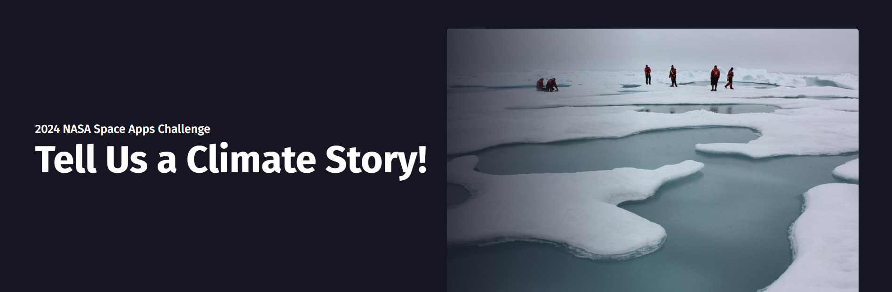
Team: AstroHacks
Shalvin Shabu
A.V Dhananjay
Ronald K.S
Sanjay P.J
Ajith Vargese T.H
Vishnu Mohan P

Slide 2


THE CHALLENGE DESCRIPTION
Over the last several decades, a huge amount of climate data from numerous sources has been collected. This data is freely available to the public, but making sense of this vast amount of data is not easy! Your challenge is to use the open-source data on the U.S. Greenhouse Gas Center website to tell a compelling story about climate change.
AstroHacks

Slide 3

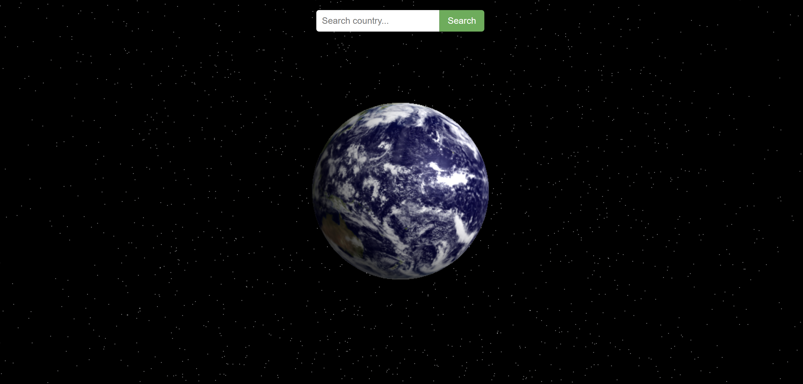
SOLUTION
Our solution for the challenge was to create a website to visualize the changes happened across the globe through datas like the Co2 emissions, methane emissions and the temperature difference by showcasing them on the basis of countries.
Home Page Of The Demo Website

Slide 4
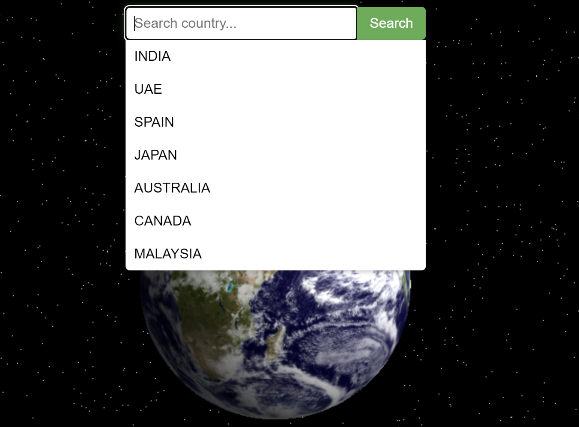
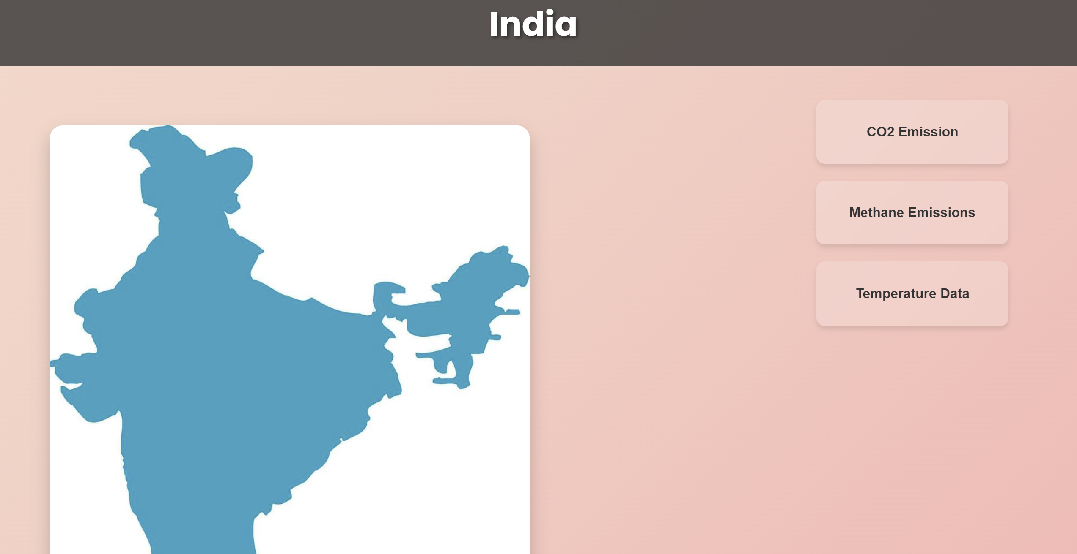
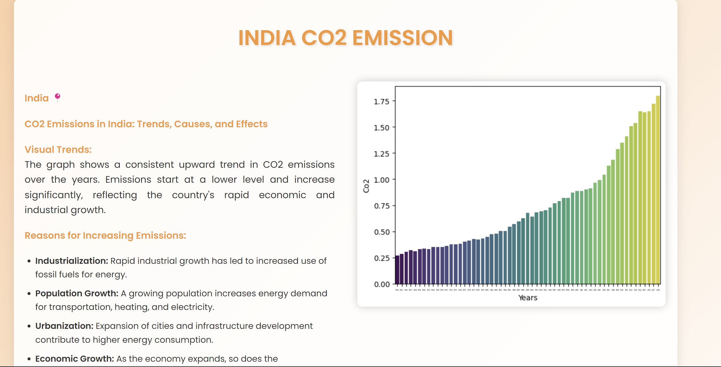
CORE FUNCTIONALITIES
The website will have functionalities to select each country and view the datas like Co2 emissions, Temperature data and Methane Emissions as bar charts for the time being. More functionalities could be added to the website later like ML models to predict the future changes and also more datas including more countries across the globe
Sample Images Of Website UI
AstroHacks

Slide 5

Github Links To The Website And The Datasets
https://ajithvargheseth.github.io/NASA-Space-Apps-Challenge-TEAM-Astrohacks/ - Link To The Website
https://github.com/AjithVargheseTH/NASA-Space-Apps-Challenge-TEAM-Astrohacks/tree/main/NASA%20Python%20WS - Link To The Datasets Used
https://github.com/AjithVargheseTH/NASA-Space-Apps-Challenge-TEAM-Astrohacks - Link To The Github Repository
AstroHacks

Slide 6
FUTURE MODIFICATIONS
In the future the website could be modified with more datasets and ML models which could help us predict the climate change values in the upcoming years.
AstroHacks

Slide 7
Tools Used
Cursor AI
Jupyter Notebook on VS Code
Excel
Kaggle for datasets
HTML,CSS
Python
AstroHacks

